Slide 1
ERTS Final Assessment – Task 2 (Template)
Name 1, Name 2

Slide 2
Guidance for this presentation
This presentation is assessed and will form your mark for the second task
Keep explanations concise, use screenshots or bullet points to present information
You will have 5 minutes to present this, this is a strict limit and you will be timed
Use the time as you feel appropriate
Use your code and robot to help you present what you have done
You will also be asked questions after your presentation
Delete this slide

Slide 3
Practical elements
Show that the LED has been used effectively
Show that the robot can move around effectively
Show that the robot can play a tune
Show that all of this works simultaneously

Slide 4
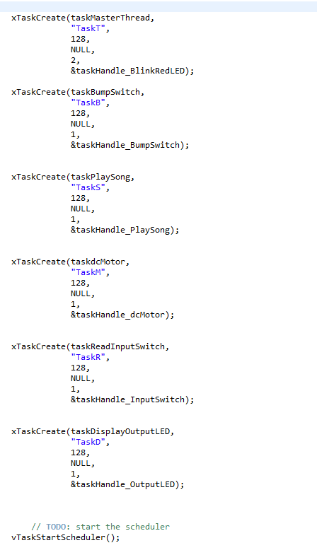
Tasks/Scheduling
We created various tasks with “taskMasterThread” having the highest priority and utilised the round robin scheduling system
With round robin at a high frequency all tasks seem to be running concurrently on a single processor
Tasks are easily able to be suspended and resumed rejoining the schedule

Slide 5
Resource control
How have you controlled access to any shared data/hardware?

Slide 6
Suspend and Delete
What is the difference between suspend and delete task and what are their uses ?
Tasks that are deleted are removed from all ready, blocked, suspended and event lists. No longer able to be used. Useful to delete a task and free memory.
Suspended tasks are unable to execute unless explicitly told to meaning it can stop and resume to join the round robin schedule again

